Slide 1
.NET Notts
Talks from the world of Microsoft and beyond

Slide 2












In our event today we ask everyone to:
Be aware of others
Be friendly and patient
Be welcoming and respectful
Be open to all questions and viewpoints
For our full Code of Conduct or to report an issue, go to:
bit.ly/dotnetnottscoc
Be understanding of differences
Be kind and considerate to others

Slide 3



THANKS TO
OUR SPONSORS!

Slide 4
Connecting to the WiFi
1. Connect to GWNET (NOT EWNET!)
2. Enter your Name and Email Address and Click Next
3. Enter chris.emerson@cgi.com as the sponsor email

Slide 5

Have you thought about becoming a Microsoft MVP?

Slide 6
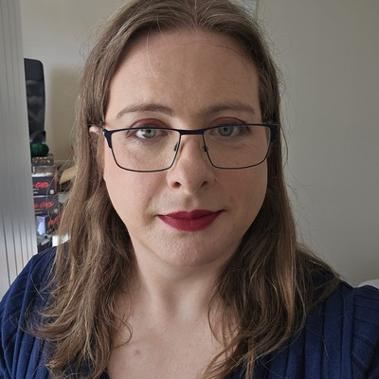
TONIGHT!
{{SpeakerName}}
{{TalkTitle}}
{{ShortUrl}}

Slide 7
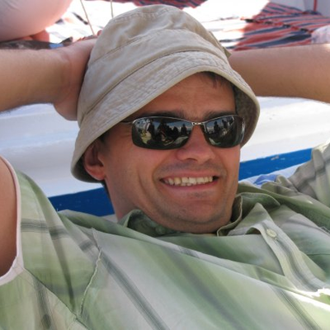
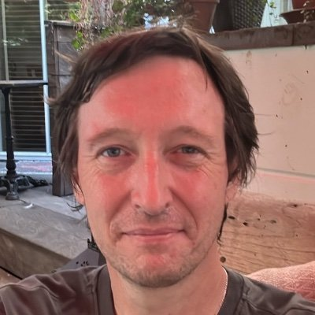
TONIGHT!
{{EventSubtitle}}
{{Speaker1Name}}
{{Talk1Title}}
{{Speaker2Name}}
{{Talk2Title}}
{{ShortUrl}}

Slide 8
Upcoming meetups

Slide 9
{{EventDate}}
{{EventTime}} {{Venue}}
{{EventSubtitle}}
{{SpeakerName}}
{{TalkTitle}}
{{ShortUrl}}

Slide 10
{{EventDate}}
{{EventTime}} {{Venue}}
{{EventSubtitle}}
{{Speaker1Name}}
{{Talk1Title}}
{{Speaker2Name}}
{{Talk2Title}}
{{ShortUrl}}

Slide 11
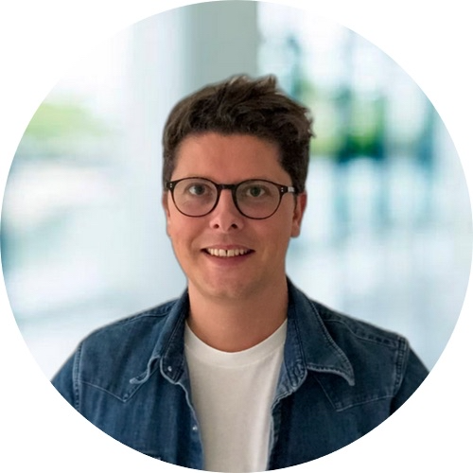
Thursday July 10th 2025 from 18:30BST On Zoom
Christophe Crémon
Agents of Change: How Agentic AI is Revolutionizing Every Industry
Pete Gallagher
Detecting Pollinating Insects with a Raspberry Pi and the Hailo AI Kit

Slide 12

HOLIDAY TIME!

Slide 13
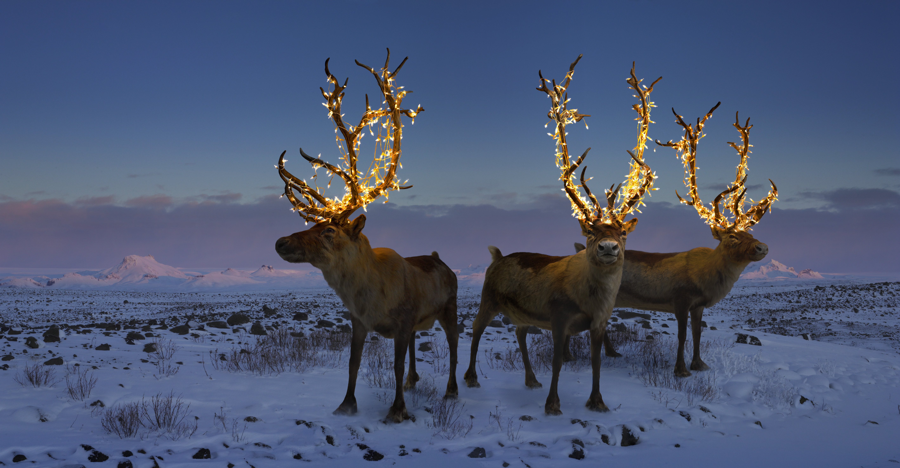
HOLIDAY TIME!

Slide 14
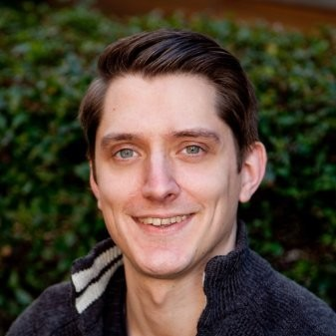
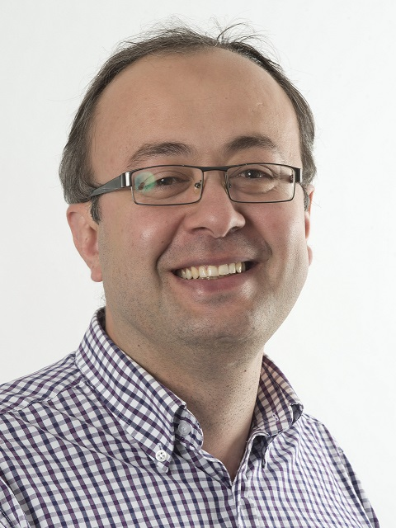
LATi Sessions
20th November 2024 from 5.30pm @ The Careers and Enterprise Hub
Data Science and AI
Mike Pound
AI and Diminishing Returns
Firat Batmaz
Vision, AI, Autonomous and Human Centred Systems

